Slide 1
Crash Course - Java3D
M. Bojja

Slide 2
Course Contents
  Overview of 3D graphics and APIs
  Java-3D Overview
  Building a Scene graph
  A sample Java3D Application
  Java3D classes and methods
  Resources.

Slide 3
Evolution of 3D graphics
Eighties – Raster based
Nineties – Low-level graphics APIs
Millenium – High-level / scene graph based APIs

Slide 4
3D Graphics Pre-requisites
Computer Graphics
Programming Language
Application Programming Interface
  Low-level:
    OpenGL, DirectX, Mesa3D or others
  High-level:
    OpenGL Optimiser or others
  Scenegraph based:
    Java3D, OpenGL Performer, OpenSG OpenSceneGraph, or others.
Modelling 3D models.
Loaders for external models
Other Resources.

Slide 5
What we benefit from High-level Graphics APIs
Easy of learning.
Productivity.
Raise the programming floor.
Reliability – Tested code.

Slide 6
Which Graphics APIs meet my requirements.
Low-level APIs
  Higher Performance
  More flexibility
High-level Scenegraph APIs
  Ease of Learning
  Productive

Slide 7
Any Questions ?
Okay now we look into Java3D API.

Slide 8
Java3D API
Overview
Scene graph construction mechanism
Building a sample application.
Discussing graphics techniques-
  Such as Geometry, appearance, text, texture, lights, behavior, interaction and others.
Resources

Slide 9
Overview
What is Java-3D ?
Layers of Java3D API
How can I benefit from it?
Java3D needed software
Where can I find information?
How to install and run.

Slide 10
What is Java3D
Java3D is a network-centric, scene-graph based API that enhances the power of 3D graphics application development.
It work as a standalone application / Applet.
Benefits of Java3D usage:
  Application portability.
  Hardware Independance.
  Performance scalability.
  High Productivity.

Slide 11
Layers of Java3D API
Programming language
Low level graphics API
  OpenGL / DirectX
Java3D

Slide 12
How can I benefit from it
Ease of Use.
Network / web support.
Performance scalability.
Productivity

Slide 13
Java3D needed software
Java run-time environment.
Java SDK
An IDE – Jbuilder, Realj, or others.
Java3D
Java Media API
Network based tools

Slide 14
Where can I find Information
Java RT and SDK 1.4.2– http://java.sun.com/j2se/downloads.html
IDE – www.realj.com (simple and free)
Java3D :
  SDK v1.3.1- http://java.sun.com/products/java-media/3D/download.html
  Specification – http://java.sun.com/products/java-media/3D/forDevelopers/j3dguide/j3dTOC.doc.html
  Following two sources should meet all your requirements –
    http://java.sun.com/products/java-media/3D/collateral/
    www.j3d.org

Slide 15
How to install and run
Download the software
Read the readme document.
Install the software by following instructions given in the readme.
Set the path for ...files.
  ...\j2SDK1.4.2\jre\lib\ext\
    J3dcore.jar, J3dutils.jar, J3daudio.jar and Vemath.jar
Play with the provided examples
In ...\java sdk\demo\java3D\.
...

Slide 16
??
Any Questions

Slide 17
Scene graph construction mechanism
Think
  Objects – not vertices
  Content – not rendering process
Program
  Objects
  Placement
  Group

Slide 18
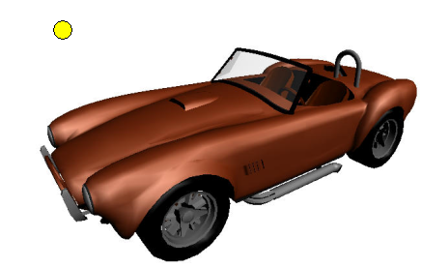
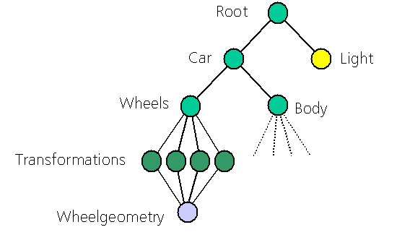
A conceptual Scenegraph

Slide 19
Scenegraph Components
Universe
world
Node
Core Node
Parent
Child
DAC (Directed Acyclic Graph)

Slide 20
Constructing an application
Typical application creates 3D content followed by sccene graph based representation.
  Root node consists, several group nodes and leaf nodes.
There is only one path from root node to the leaf node
  I.e. children can not have more than one parent.
A scenegraph can be represented by a tree-like diagram, typically with two braches
  View branch for viewing controls
  Content branch for 3D shapes, lights, and others.

Slide 21
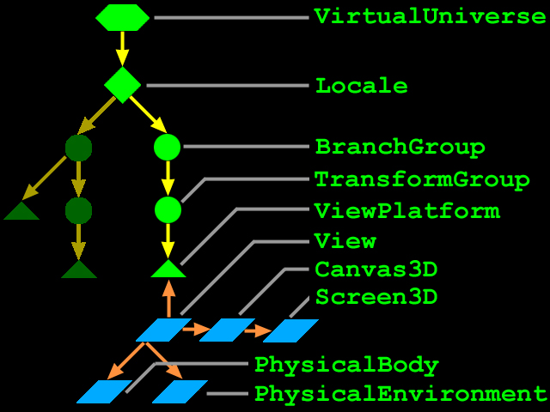
The view branch

Slide 22
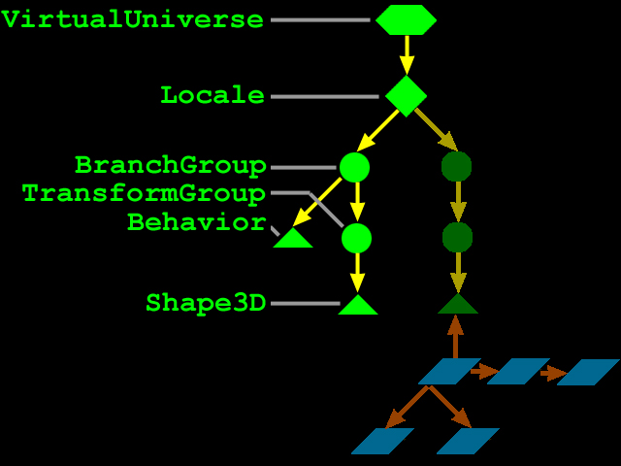
The content branch

Slide 23
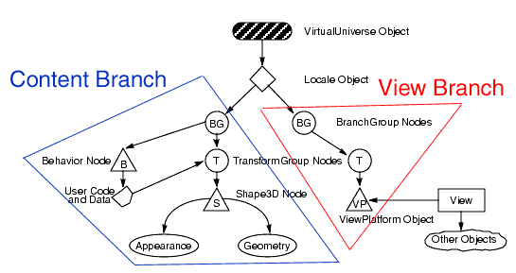
The view and content branches

Slide 24
SceneGraph base classes
Scene graph components are derived from the following base classes:
  SceneGraphObject – is the base class for all objects that may be included in a scene graph.
  It‘s Subclasses create shapes, lights, and others.
    Node – is the base class for all items on the rendering path through a scene graph
      Group – BranchGroup, TransformGroup, and others
      Leaf – Shape3D, Backgrround, Lights, Behavior and others.
    NodeComponent – is the basse class for attibutes associated with nodes
      geometry, appearance, attributes, texture and others

Slide 25
SceneGraph base classes hierarchy
Class Hierarchy:
  Java.lang.Object
    Javax.media.j3d.SceneGraphObject
      Javax.media.j3d.Node
      Javax.media.j3d.NodeComponent
Java3D class hierarchy diagram
http://java.sun.com/products/java-media/3D/collateral/j3dclass.html

Slide 26
Example „Hello Java3D“ Application
Setup the frame to draw into
Public static void main ( String[] args )
{
new MainFrame (new HelloJava3D(), 800, 480);
}

Slide 27
Example „Hello Java3D“ Application
Construct the view and content branches
  Use SimpleUniverse to make a typical view branch
  Public HelloJava3D()
  {
  // Create a Canvas3D object and add it to the panel.
  Canvas3D c = new Canvas3D( null);
  add( „Center“, c );
  // Create the View Branch
  SimpleUniverse u = new SimpleUniverse ( c );
  // Create the Content Branch and attach it to the simple universe.
  BranchGroup scene = createSceneGraph();
  u.addBranchGraph (scene);
  }

Slide 28
Example „Hello Java3D“ Application
Scene content creation
Public BranchGroup createSceneGraph ( )
{
// Create the root of the branch graph.
BranchGroup objRoot = new BranchGroup ( );
// Create the TransformGroup node and initialize it to the identity. Enable the
// TRANSFORM_WRITE capability so that our behavior code can modify it at run // time. Add it to the root of the subgraph (above branch graph).
TransformGroup objTrans = new TransformGroup ( );
objTrans.setCapability( TransformGroup.ALLOW_TRANSFORM_WRITE );
objRoot.addChild( objTrans );
// Create a simple shape3D node and add to the scene graph.
objTrans.addChild( new ColorCube (0.4 ));

Slide 29
Example „Hello Java3D“ Application
Rotation behavior setup
// Create a new behavior object that will perform the desired rotation.
Transform3D yAxis = new Transform3D ( );
Alpha rotationAlpha = new Alpha ( -1, 4000 );
RotationInterpolator rotator = new RotationInterpolator (
rotationAlpha, objTrans, yAxis,
0.0f, (float) Math.PI*2.0f);
BoundingSphere bounds =
new BoundingSphere (new Point3d ( 0.0, 0.0, 0.0 ), 100.0 );
rotator.setSchedulingBounds ( bounds );
// Add it to the scene graph.
objTrans.addChild ( rotator );

Slide 30
Example „Hello Java3D“ Application
Compile and Done
// Optimise scene
objRoot.compile ( );
return objRoot;
}

Slide 31
Example „Hello Java3D“ Application
Typical import statements
import javax.media.j3d.*;
import javax.vecmath.*;
import java.applet.Applet.*;
import java.awt.*;
import com.sun.j3d.utils.applet.MainFrame;
import com.sun.j3d.utils.universe.*;
import com.sun.j3d.utils.geometry.*;
import com.sun.j3d.utils.behaviors.*;
Hello Java3D universe

Slide 32
Constructing a scene graph and some superstructure objects
Shape3D MyShape1 = new Shape3D (myGeometry1, myAppearance1);
Shape3D MyShape2 = new Shape3D (myGeometry2, myAppearance2);
TransformGroup MyjTrans = new TransformGroup ( );
BranchGroup myBranch = new BranchGroup();
myBranch.addChild(myShape1);
myBranch.addChild(myShape2);
myBranch.addChild(MyTrans);
myBranch.compile();
// For Complex applications that needs various layers/level of information to be processed.
VirtualUniverse myUniverse = new VirtualUniverse();
Locale myLocae = new Locale(myUniverse);
myLocale.addBranchGraph(myBranch);
      Or
// For Simple worlds.
SimpleUniverse myUniv = new SimpleUniverse(myCanvas);
myUniv.addBranchGraph(myBranch).

Slide 33
Group Node Objects
Group Nodes assist as glue elements in constructing a scene graph.
All group nodes can have a variable number of child node objects including other group nodes as well as leaf nodes.
Group nodes have exactly one parent and an arbitrary number of children.
  Group Node
  BranchGroup Node
  TransformGroup Node
  OrderedGroup Node
  DecalGRoup Node
  Switch Node
  SharedGroup Node

Slide 34
Leaf Node Objects
Leaf nodes define atomic entities such as grometry, lights, sounds and others.
Leaf nodes provide special linking and instancing capabilities for sharing scene graphs.
Also provides a view platform for positioning and orienting a view in virtual world.

Slide 35
NodeComponent Objects
NodeComponent objects include the actual geometry and appearance attributes used to render the geometry.
  Appearance attributes:
    Coloring, point, line, polygon, texture, and others.
  Geometry attributes:
    TriangleArray, QuadArray, TriangleStripArray, TriangleFanArray, IndexedTriangleArray and others.

Slide 36
Content creation
Java3D provides ready-to-use classes for creating 3D content
  BR / CSG based
  Lights and sounds
  Backgrounds and fog
  Groups and animations
  And others.

Slide 37
Content Development
Geometry Creation.
  CSG Models.
  BR Models.
Developing models in a 3D modeller.
  3D Studio Max
  Maya
  ...
Loading / Import of 3D models.
  Loaders such as .wrl, .obj, .max and others.

Slide 38
Java3D coordinate system
is right handed
i.e.
  The X-axis is the +ve to the right
  The Y-axis is the +ve to the up
  The Z-axis is the +ve towards the viewer
With angles in radians
With distance in meters.

Slide 39
Creating 3D shapes
The Shape3D object defines a visual object in a scene graph
  Shape3D (Geometry geoemtry, Appearance appearance)
The Shape3D leaf node contains :
  Geometry and / or Appearance information
Geometry describes the form or structure of a shape
  Several types of geometry are available such as geometric primitives, geometry arrays, geometrystrips, and others.
Appearance describes the color, material, texture and other such of a shape

Slide 40
Creating Geometry
Geometry utility classes:
  The geometric primitives such as Box,Cone, Cylinder and Sphere are easiest choice to create content in virtual unninverse.
  Box: Technically a box is a six-sided polyhedron with rectangular faces
  The default values: for length, width, height are 2 meters with the center as ist origin and corners at (-1, -1, -1) and (1, 1, 1)

Slide 41
Vertex based shape creation
To create visual objects other than what we learned so far, we use vertex-based primitives such as points, lines and filled polygons.
Each vertex of a visual object may need to specify upto four javax.vecmath objects, representing coordinates, colors, surface normals and texture coordinates. They are:
  Point* ( for Coordinates)
  Color* (for Colors)
  Vector* (for Surface normals)
  TexCoord* (for Texture coordinates)

Slide 42
Geometry Arrays
GeometryArray is extended to build:
  Simple geometry
    PointArray, LineArray, TriangleArray and QuadArray
  Strip geometry
    LineStripArray, TrinagleStripArray and TriangleFanArray

Slide 43
GeometryArray class components
The GeometryArray parent class components
  GeometryArray
    Coordinates
    Colors
    Surface normals
    Texture coordinates
  Appearance
Classes extend GeometryArray to build specific geometries

Slide 44
Indexed GeometryArrays
IndexedGeometryArray is extended to build:
  Indexed simple geometry
    IndexedPointArray, IndexedLineArray, IndexedTriangleArray, and IndexedQuadArray
  Indexed stripped geometry
    IndexedLineStripArray, IndexedTriangleStripArray, and IndexedTriangleFanArray

Slide 45
IndexedGeometryArray class components
The IndexedGeometryArray parent class entends the GeometryArray class and adds:
  IndexedGeometryArray
    Coordinates
    Colors
    Surface normals
    Texture coordinates
  Appearance
Classes extend IndexedGeometryArray to build specific geometries

Slide 46
Class methods for
GeometryArray
  void setCoordinate (int index, *coordinate)
  void setCoordinates (int index, *coordinate)
  void setColor (int index, *Color)
  void setColors (int index, *Colors)
  ....
IndexedGeometryArray
void setCoordinateIndex (int index, int value)
void setCoordinateIndices (int index, int[] value)
void setColorIndex (int index, int value)
void setColorIndices (int index, int[] value)
....
....

Slide 47
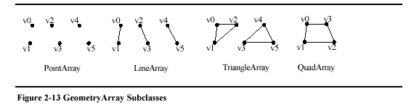
Building specific shapes using Extended GeometryArray components
PointArray points = new PointArray (vertexCount, GeometryArray.COORDINATES)
  Points.setCoordinates ( 0, coords )
LineArray lines = new LineArray (vertexCount, GeometryArray.COORDINATES)
  Lines.setCoordinates ( 0, coords )
TriangleArray triangles = new TriangleArray (vetexCount,
GeometryArray.COORDINATES | GeometryArray.NORMALS )
  triangles.setCoordinates (0, coords )
  Triangles.setNormals (0, normals )
QuadArray quads = new QuadArray (vertexCount,
GeometryArray.COORDINATES | GeometryArray.NORMALS )
  Quads.setCoordinates (0, coords)
  Quads.setNormals (0, normals)

Slide 48
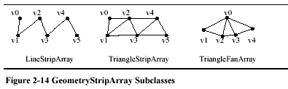
Building specific shapes using Extended GeometryArray components
LineStripArray mlines = LineStripArray (vertexCount, GeometryStripArray.COORDINATES, StripVertexCounts [ ] )
  Mlines.setCoordinates (0, coords )
TriangleFanArray triFans = new TriangleFanArray (vertexCount, GeometryArray.COORDINATES | GeometryArray.NORMALS, stripVertexCounts[ ])
  triFans.setCoordinates (0, coords)
  triFans.setNormals (0, normals)
TriangleStripArray triStrips = new TriangleStripArray (vertexCount, GeometryArray.COORDINATES | GeometryArray.NORMALS, stripVertexCounts [ ])
  triStrips.setCoordinates (0, coords)
  triStrips.setNormals (0, normals)
  Sample Code

Slide 49
GeometryInfo
To create complex models, using GeometryInfo utility class reduce the time and tedium of geometry creation.
Instead of specifying each triangle, you can specify arbitrary polygons; concave, non-planar polygons or even with holes.
The GeometryInfo object and other utility classes convert the geometry into a triangular geometry that java3D can render.

Slide 50
GeometryInfo and other utility classes
GeometryInfo – to specify the shape profile
Triangulator – to convert the profile into a network of triangles
Stripifier – to optimise the performance viz. A network of stripped triangles.
NormalGenerator – to generate the normals for the obtained triangles

Slide 51
A simple GeometryInfo Example
User has several choices to specify the geometry type needed.
Paste the code fragment 3-2 from J3D tutotial
And the working example as well
Sample work Sample Code

Slide 52
Using Text in Java3D
Text2D objects are rectangular polygons with text applied as texture.
Instances of Text2D can be children of group objects
  To place Text2D in Java3D scene.
    Simply create a Text2D object
    Then add it to the scene graph
A simple coding procedure
  BranchGroup objRoot = new BranchGroup()
  Text2D text = new Text2D („Wellcome to 2D text“, new Color3f(1.0f, 0.0f, 0.0f), „Helvetica“, 16, Font.ITALIC)
  objRoot.addChild (text2D)
Text3D object is an extruded geometry. The construction procedure is similar to the Text2D, in addition it needed a reference location for placing in the 3D scene.

Slide 53
Modelling 3D objects
Soft – 3D Max, Maya, etc.
Create 3D models
Export into supported formats

Slide 54
Loaders for External Models
Load the authored content from these files:
  Objects
  Scenes
  Animations
There are several loaders for file formats such as *.wrl, *.obj, *.max and others.
Provide a uniform interface.

Slide 55
Typical working style of Loading
Construct a loader (or use a loader utility)
  Open and parse a content file
  Convert content into java3D objects
Retrieve the „Loaded“ objects
  Objects
  Backgrounds
  Lights
  sounds
Insert them into universe

Slide 56
Example code
ObjectFile extends Group and sets it s children to content from an *.obj file
  TransformGroup group = new TransformGroup ()
  .....
  ObjectFile f = new ObjectFile (flags, creaseRadians )
  Scene scene = f.load( filename )
  .....
  Group.addChild (s.getSceneGroup() )
  Sample work Sample Code

Slide 57
Texture Mapping
To reduce actual scene detail without reducing apparent scene detail
  Stretch and paste an image onto 3D geometry
  Increases realism without increasing the amount of geometry
Texture mapping is controlled by attributes of an Appearance node component
The Texture base class is extended for 2D and 3D textures using Texture2D and Texture3D
  These classes enable/disable texture mapping, and select the image to use

Slide 58
Example Code
TextureLoader loader = new TextureLoader( „test.jpg“, this)
imageComponent2D image = loader.getImage()
Texture2D texture = new Texture2D()
Texture.setImage (0, image)
Appearance appear = new Appearance()
Appear.setTexture(texture)
QuadArray plane = new QuadArray(4, GeometryArray.COORDINATES | GeometryArray.TEXTURE_COORDINATE_2)
Point3f p = new Point3f()
P.set(-1.0f, 1.0f, 1.0f)
Plane.setCoordinate(0, p)
.... Other corners
Point2f q = new Point2f()
Q.set(0.0f, 1.0f)
Plane.setTextureCoordinate(0, q)
.... Other corners

Slide 59
Behaviors
Programability
  Behaviors are just java methods
Behavior nodes provide the means for animation, processing mouse and keyboard inputs, and other behaviors.
Behavior nodes contain Java code and state variables.
Sample behavior state variables have been already shown in the HelloJava3D example.

Slide 60
Behaviors
Behavior object extends the Leaf class.
Every behavior contains: - Behaviors ( )
  An initialize method – void initialize ( )
  Code to run, contained within a processStimulus method – void processStimulus ( )
  Wakeup conditions controlling when to run next – void setEnable ( boolean ON / OFF )
    Respecified on each wakeup
  Scheduling bounds controll scheduling
    When the viewer's activation radius intersects the bounds, the behavior is scheduled

Slide 61
Behaviors
A behavior can do anything
  Perform computations
  Update its internal state
  Modify the scene graph
  Start a thread
For example, a behavior to rotate a radar dish to track an object:
  Wakeup frequently
  Get the object's location
  Create transform to re-orient radar dish
  Set TransformGroup of radar dish
  Return

Slide 62
Creating and anchoring scheduling bounds
A behavior's scheduling bounds is a bounded volume
  Sphere, box, polytope, or combination
  To make a global behavior, use a huge bounding sphere
By default, behaviors have no scheduling bounds and are never executed!
  common error : forgetting to set scheduling bounds
A behavior's bounding volume can be relative to:
  The behavior's coordinate system
  Volume centered on origin
  As origin moves, so does volume
A Bounding leaf's coordinate system
  Volume centered on leaf node elsewhere in scene graph
  As that leaf node moves, so does volume
  If behavior's origin moves, volume does not

Slide 63
Scheduling bounds Example code
Void setSchedulingBounds ( Bounds bounds )
Void setSchedulingBoundingLeafs ( BoundingLeaf leaf )
Set bounds relative to the behavior's coordinate system
  Behavior behavior = new MyBehavior ( )
  Behavior.setSchedulingBounds ( bounds )
Or relative to a bounding Leaf`´s coordinate system
  TransformGroup group = new TransformGroup
  BoundingLeaf leaf = new BoundingLeaf ( bounds )
  Group.addChild ( leaf )
  ........
  Behavior behavior = new MyBehavior ( )
  Behavior.setSchedulingBoundingLeaf ( leaf )

Slide 64
Waking up a behavior
Even when scheduled, a behavior runs only when wakeup criterion are met
  A number of frames or milliseconds have elapsed
  A behavior or AWT posts an event
  A transform changes in a TransformGroup
  A shape collides with another shape
  A view platform or sensor gets close
Multiple criteria can be and/or-ed to form wakeup conditions
WakeupCriterion extends the WakeupCondition base class

Slide 65
Wakeup condition example – Mouse behavior
Behavior behavior = new MyBehavior ( )
...
WakeupCriterion [ ] onMouseEvents =
new WakeupCriterion [2]
onMouseEvents [0] =
new WakeupOnAWTEvent ( MouseEvent.MOUSE_PRESSED )
onMouseEvents [1] =
new WakeupOnAWTEvent ( MouseEvent.MOUSE_RELEASED )
WakeupCondition onMouse = new WakeupOr ( onMouseEvents )
Behavior.wakeupOn ( onMouse )
Behavior.setSchedulingBounds ( bounds )
sample work Sample code

Slide 66
A specialized Behavior : Level-of-Detail
Level-of-Detail (LOD) is a specialized behavior that:
  Tracks the ViewPlatform
  Computes a distance from viewer to a shape
  Maps the distance to target Switch(es) choices
The LOD abstract class generalizes level-of-detail behaviors
The DistanceLOD class implements distance-based switching level-of-detail

Slide 67
LOD and DistanceLOD class Methods
LOD ( )
Void setSwitch ( Switch switch, int index )
Void addSwitch ( Switch switch )
Void insertSwitch ( Switch switch, int index )
Void removeSwitch ( int index )
DistanceLOD ( )
Void setDistance ( int whichLOD, double distance )
Default values are set to none.
sample work Sample work

Slide 68
Picking shapes
Selection is essential to interactivity
  Without an ability to select objects you cannot manipulate them
The picking API enables selecting objects in the scene
  Various selection shapes
  First, any, all, all sorted (from closest to furthest)

Slide 69
Types of Picking shapes
Picking intersects a PickShape with pickable shape bounding volumes
PickPoint checks the scene at a position
  Pick occurs for shape bounds that contain the position
PickRay fires a ray from a position, in a direction
  Pick occurs for shape bounds the ray strikes
PickSegment fires a ray along a ray segment between two positions
  Pick occurs for shape bounds the ray segment intersects

Slide 70
Picking shapes components
PickShape extends the java.lang.Object class
The three pick shape types extend the PickShape
Getting Pick Results:
  The pick methods on Locale or BranchGroup return one or more SceneGraphPaths)
  Each SceneGraphPath contains:
    A Node for the object that was picked
    The Locale above it in the scene graph
    A list of the Nodes from the picked object up to the Locale
    The world-to-object transform

Slide 71
Picking Example using the Mouse
  Create a behavior that wakes up on a mouse press event
  On mouse press:
    Construct aPickRay from the eye passing through the 2D mouse screen point
    Wait for mouse drag or mouse release event
  On mouse drag:
    Update ray to pass through new 2D mouse point
    Wait for mouse drag or mouse release event
  On mouse release:
    Update ray to pass thorugh last 2D mouse point
    Use Java 3D pick method to generate the first object intersected by the ray
    Get the pick object and do something to it
    (Re)declare interest in mouse press events

Slide 72
Picking Example Code
  PickRay ray = new PickRay ( origin, direction )
  SceneGraphPath results = locale.pickAllSorted ( ray )
  Node pickedObject = results.getObject ( )
  sample work Sample work

Slide 73
Lights
Java 3D provides four types of lights:
  Ambient
  Directional
  Point
  Spot
All lights share common attributes:
  An on/off enable state
  A color
  A bounding volume and scope controlling the range of shapes they illuminate

Slide 74
Lights – class and its methods
Light abstract class methods
  void setEnable ( boolean ON / OFF )
  void setColor ( Color3f, Color )
All lights share attributes inherited from the Light abstract class

Slide 75
In Ambient Light case
AmbientLight extends the Light class
  Light rays aim in all directions, flooding an environment and illuminating shapes evenly
Use ambient lights to raise the overall light level
  Low ambient light makes artificial contrasty imagery
  High ambient light looks washed out
Usually one ambient light in the scene is enough
Code extract from the example :
TransformGroup group = new TransformGroup ( )
...
AmbientLight AmbiLight = new AmbientLight ( )
AmbiLight.setEnable ( true )
AmbiLight.setColor ( new Color3f (1.0f, 0.0f, 0.0f))
...
AmbiLight.setSchedulingBounds ( bounds )
Group.addChild ( AmbiLight )
sample work

Slide 76
Sounds
You can add sounds to your environment, viz:
  Localized sounds - sounds with a position
  Background sounds - sounds filling an environment
Types of sounds
  Java 3D provides three types of sounds:
    Background, Point, and Cone
All three types of sounds have:
  Sound date to play
  An initial gain ( overall volume )
  Looping parameters
  Playback priority
  Scheduling bounds ( like in behavior )
  All sounds share attributes inherited from the Sound abstract class

Slide 77
Sounds requirements
The MediaContainer class provides functionality to load sound files given a URL or file path
Typical sound file formats include: *.AIF, *.AU, and *.WAV
Controlling sounds:
  Sounds may be enabled and disabled
    Enabling a sound makes it schedulable
    The sound will start to play if the sound's scheduling bounds intersect the viewer's activation radius
  Overall sound volume may be controlled with a gain multiplication factor

Slide 78
Sound class Methods
Void setSoundData ( MediaContainder sound ) - None
Void setLoop ( int count ) - 0
Void setEnable ( boolean ON / OFF ) - false
Void setInitialGain ( float amplitude ) - 1.0
  Special loop count values:
        A ´0´ count loops 0 times (play once through)
    A ´-1´ count loops forever
At the moment I explain the construction of background sound type.
  The other two are similar to point and cone light construction methods.

Slide 79
Background sounds
BackgroundSound extends the Sound class
  Background sound waves come from all directions, flooding an environment at constant volume
  Similar idea as an AmbientLight
Use background sounds for:
  Presentation sounds (voice over, narration)
  Environment sounds (ocean waves, wind)
  Background music
You can have multiple background sounds playing

Slide 80
BackgroundSound Example
MediaContainer music = new MediaContainer ( „Sound.wav“ )
......
TransformGroup group = new TransformGroup ( )
......
BackgroundSound Bsound = new BackgroundSound ( )
Bsound.setInitialGain ( 1. 0f)
Bsound.setEnable ( true )
Bsound.setLoop ( -1 ) // Loop / play forever
Bsound.setSchedulingBounds ( bounds )
Group.addChild ( Bsound )
Sample work Sample Code

Slide 81
Resources
Graphics APIs - http://www.cg.tuwien.ac.at/~wimmer/apis/API_Summary.html
Comparision of Graphics APIs - http://mms.ecs.soton.ac.uk/papers/34.pdf
Comparison of High Level SceneGraph APIs – http://sgi.felk.cvut.cz/~pavlicm/Dipl/sw.htm

